Slide 1

Ray

Slide 2
Table of Contents
Architecture
Object and Object Store
Memory Management
Resource Management
Scheduling

Slide 3
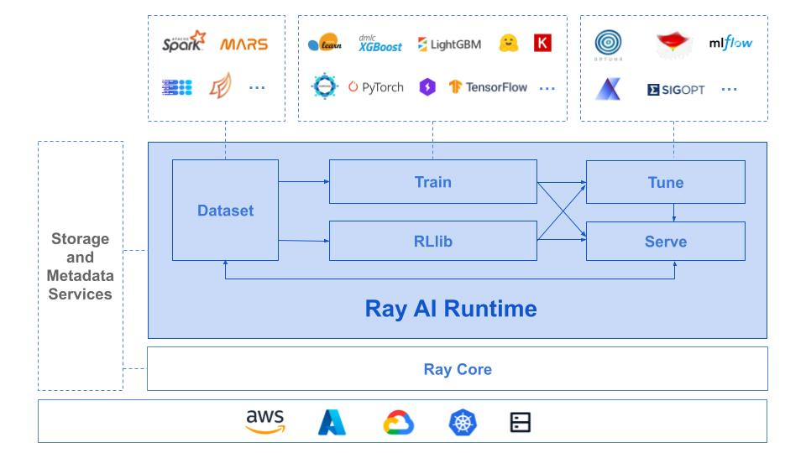
Ray: A Distributed ML Framework [1,2]
Architecture
Object
Memory
Resource
Scheduling
A distributed execution framework for emerging AI applications
Apps and libraries
Ray
Cloud service providers
[1] https://www.usenix.org/conference/osdi18/presentation/moritz
[2] https://docs.google.com/document/d/1lAy0Owi-vPz2jEqBSaHNQcy2IBSDEHyXNOQZlGuj93c/preview

Slide 4
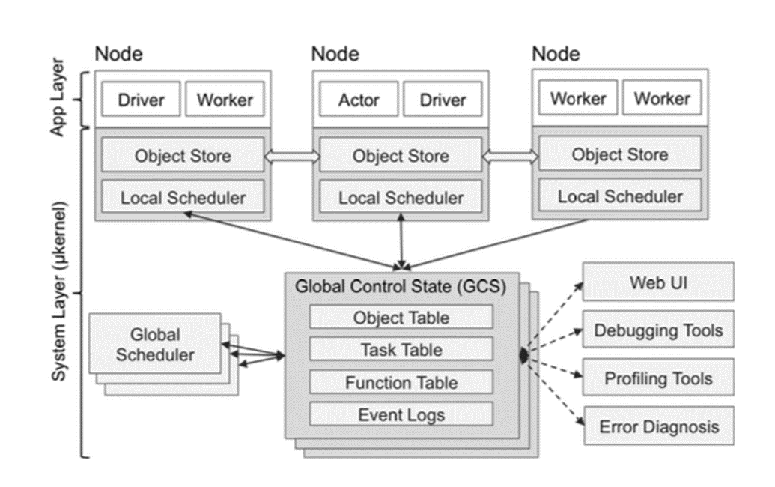
Ray: Architecture
Architecture
Object
Memory
Resource
Scheduling
Ray’s architecture consists of two parts: an application layer and a system layer.
Application layer:
Worker: a stateless process that serially executes tasks (remote functions) invoked by a driver or another worker. Workers are started automatically and assigned tasks by the system layer. When a remote function is declared, the function is automatically published to all workers.
Driver: a special worker process that executes the top-level application. It can submit tasks, but cannot execute any itself. Driver processes can run on any node.
Actor: a stateful process that serially executes, when invoked, the methods it exposes. Unlike a worker, an actor is explicitly instantiated by a worker or a driver.
Global Control Store (GCS)

Slide 5
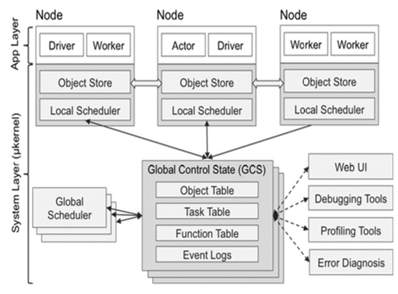
Ray: Architecture
Architecture
Object
Memory
Resource
Scheduling
Worker
a stateless process that serially executes tasks (remote functions) invoked by a driver or another worker. When a remote function is declared, the function is automatically published to all workers.
started automatically and assigned tasks by the system layer.
Driver: a special worker process that executes the top-level application. It can submit tasks, but cannot execute any itself. Driver processes can run on any node.
Actor: a stateful process that serially executes, when invoked, the methods it exposes. Unlike a worker, an actor is explicitly instantiated by a worker or a driver.
Global Control Store (GCS)

Slide 6
Ray: Architecture
Architecture
Object
Memory
Resource
Scheduling
Worker
a stateless process that serially executes tasks (remote functions) invoked by a driver or another worker. When a remote function is declared, the function is automatically published to all workers.
started automatically and assigned tasks by the system layer.
Driver
a special worker process that executes the top-level application.
It can submit tasks but cannot execute any itself.
Driver processes can run on any node.
Actor: a stateful process that serially executes, when invoked, the methods it exposes. Unlike a worker, an actor is explicitly instantiated by a worker or a driver.
Global Control Store (GCS)

Slide 7
Ray: Architecture
Architecture
Object
Memory
Resource
Scheduling
Worker
a stateless process that serially executes tasks (remote functions) invoked by a driver or another worker. When a remote function is declared, the function is automatically published to all workers.
started automatically and assigned tasks by the system layer.
Driver
a special worker process that executes the top-level application.
It can submit tasks but cannot execute any itself.
Driver processes can run on any node.
Actor
a stateful process that serially executes the methods it exposes. Unlike a worker, an actor is explicitly instantiated by a worker or a driver.
Global Control Store (GCS)

Slide 8

Ray: Architecture
Architecture
Object
Memory
Resource
Scheduling
The System Layer consists of three major components: a global control store, a distributed scheduler, and a distributed object store. More details in slides later.
• Task - A single function invocation that executes on a process different from the caller. A task is executed asynchronously with the caller.
• Object - An application value. This may be returned by a task or created through `ray.put`. Objects are immutable: they cannot be modified once created. A worker can refer to an object using an `ObjectRef`.
• Job - The collection of tasks, objects, and actors originating (recursively) from the same driver.
Global Control Store (GCS)

Slide 9
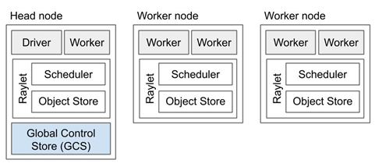
Ray: Architecture
Architecture
Object
Memory
Resource
Scheduling
A Ray cluster comprises a set of worker nodes and a centralized Global Control Store (GCS) instance.
Each worker node has:
1. One or more work processes, responsible for task submission and execution. Each is associated with a specific job. The default number of initial workers is equal to the number of CPUs on the machine.
2. A raylet. The raylet is shared among all jobs on the same cluster. The raylet has two main components, run on separate threads:
1). A scheduler. Responsible for resource management and fulfilling task arguments that are stored in the distributed object store. The individual schedulers in a cluster comprise the Ray distributed scheduler.
2). A shared-memory object store (also known as the Plasma Object Store). Responsible for storing and transferring large objects. The individual object stores in a cluster comprise the Ray distributed object store.
Each worker stores:
1). An ownership table. System metadata for the objects to which the worker has a reference, e.g., to store ref counts and object locations.
2). An in-process store, used to store small objects.

Slide 10
Ray: Architecture
Architecture
Object
Memory
Resource
Scheduling
Each worker node has:
1. One or more work processes, responsible for task submission and execution. Each is associated with a specific job. The default number of initial workers is equal to the number of CPUs on the machine.
Each worker stores:
1). An ownership table. System metadata for the objects to which the worker has a reference, e.g., to store ref counts and object locations.
2). An in-process store, used to store small objects.
One of the worker nodes is designated as the head node. In addition to the processes a worker load has, the head node also hosts:
The Global Control Store (GCS).
The driver process(es).

Slide 11
Ray: Architecture
Architecture
Object
Memory
Resource
Scheduling
Each worker node has:
One or more work processes, responsible for task submission and execution. Each is associated with a specific job. The default number of initial workers is equal to the number of CPUs on the machine.
2. A raylet. The raylet is shared among all jobs on the same cluster. The raylet has two main components, run on separate threads:
1). A scheduler. Responsible for resource management and fulfilling task arguments that are stored in the distributed object store. The individual schedulers in a cluster comprise the Ray distributed scheduler.
2). A shared-memory object store (also known as the Plasma Object Store). Responsible for storing and transferring large objects. The individual object stores in a cluster comprise the Ray distributed object store.
One of the worker nodes is designated as the head node. In addition to the processes a worker load has, the head node also hosts:
The Global Control Store (GCS).
The driver process(es).

Slide 12
Ray: Architecture
Architecture
Object
Memory
Resource
Scheduling
Each worker node has:
One or more work processes, responsible for task submission and execution. Each is associated with a specific job. The default number of initial workers is equal to the number of CPUs on the machine.
2. A raylet. The raylet is shared among all jobs on the same cluster. The raylet has two main components, run on separate threads:
1). A scheduler. Responsible for resource management and fulfilling task arguments that are stored in the distributed object store. The individual schedulers in a cluster comprise the Ray distributed scheduler.
2). A shared-memory object store (also known as the Plasma Object Store). Responsible for storing and transferring large objects. The individual object stores in a cluster comprise the Ray distributed object store.
One of the worker nodes is designated as the head node. In addition to the processes a worker load has, the head node also hosts:
The Global Control Store (GCS).
The driver process(es).

Slide 13
Ray: Architecture Summary
Architecture
Object
Memory
Resource
Scheduling
Design for distributed computing from the standpoint of a user.
Scenario and application: a user have access to multiple resources in cloud services (AWS, Azure, Google, etc.) and want to run different ML applications (TensorFlow, PyTorch, etc.) across these resources.
Note: App Layer in the Ray architecture is not for a layer of specific applications (Spark, PyTorch, etc.)
Distributed parallel execution: Actors, drivers, and workers run locally.
Distributed memory: Object store of each node has the capability to share memory with other nodes.
Distributed scheduler: local schedulers communicate with global schedulers and GCS for resource management and computation.
Global Control Store (GCS)

Slide 14
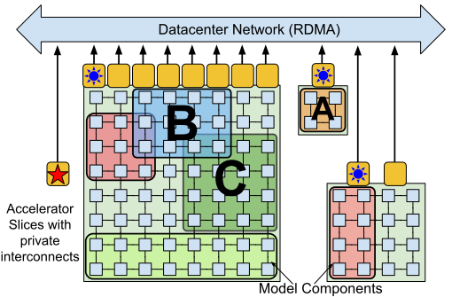
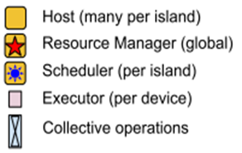
Ray: Architecture Comparison
Architecture
Object
Memory
Resource
Scheduling
Ray: Design for user
Pathway: Design for data center
Global Control Store (GCS)
Only have access to certain resources
Resource Manager: have access to all resources

Slide 15
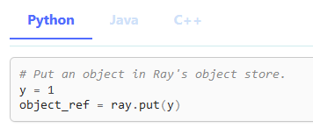
Ray: Object [3]
Architecture
Object
Memory
Resource
Scheduling
Object: an application value.
Example
Object
Object ref (as in reference)
[3] https://docs.ray.io/en/master/ray-core/objects.html

Slide 16
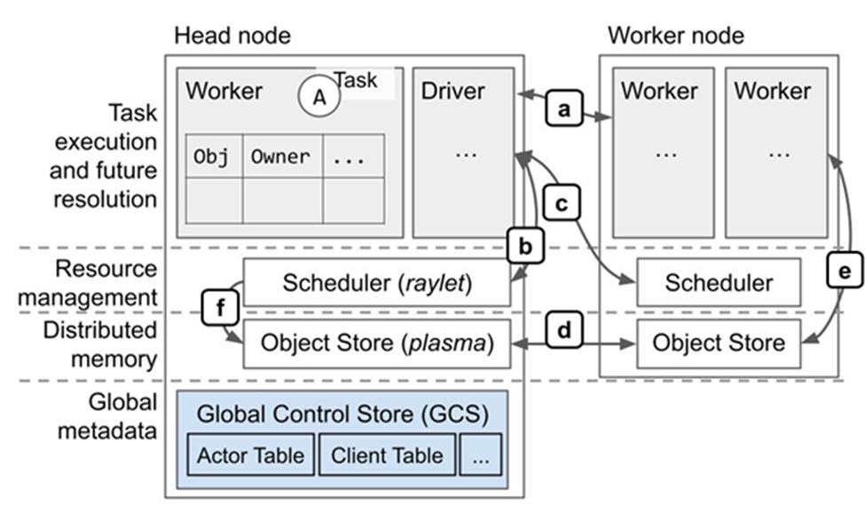
Ray: Object Store
Architecture
Object
Memory
Resource
Scheduling
Tasks and actors create and compute on objects (or remote objects), which can be stored anywhere in a Ray cluster, and referred by object refs. Remote objects are cached in Ray’s distributed shared-memory object store
One object store per node in the cluster.
Ray makes it simpler for an application to leverage parallel and distributed execution and distributed memory sharing (via a shared memory object store).
The use of distributed memory allows a process to reference an object without having the object local, so a process can reference objects whose total size exceeds the memory capacity of a single machine.

Slide 17
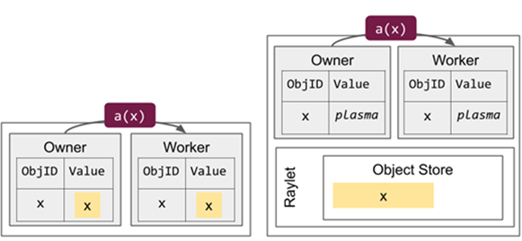
Ray: Small Object Management
Architecture
Object
Memory
Resource
Scheduling
Small objects (default threshold is 100KB) are resolved by copying them directly from the owner’s in-process store.
The value of an object can be resolved using an `ObjectRef`. The `ObjectRef` comprises two fields:
A unique 20-byte identifier, including a concatenation of the ID of the task that produced the object and the integer number of objects created by that task so far.
The address of the object’s owner (a worker process), including the worker process’s unique ID, IP address and port, and local raylet’s unique ID.
Small objects are local to the owner process: if a borrower attempts to resolve the value, the object is promoted to shared memory, where it can be retrieved through the distributed object resolution protocol.
Large objects are stored in the distributed object store.
Small objects are stored in their owner’s in-process store.
For example, if the owner calls `ray.get`, the system looks up and deserializes the value from the local in-process store. If the owner submits a dependent task, it inlines the object by copying the value directly into the task description.

Slide 18
Ray: Small Object Management
Architecture
Object
Memory
Resource
Scheduling
Small objects (default threshold is 100KB) are resolved by copying them directly from the owner’s in-process store.
The value of an object can be resolved using an `ObjectRef`. The `ObjectRef` comprises two fields:
A unique 20-byte identifier, including a concatenation of the ID of the task that produced the object and the integer number of objects created by that task so far.
The address of the object’s owner (a worker process), including the worker process’s unique ID, IP address and port, and local raylet’s unique ID.
Small objects are local to the owner process: if a borrower attempts to resolve the value, the object is promoted to shared memory, where it can be retrieved through the distributed object resolution protocol.
Large objects are stored in the distributed object store.
Small objects are stored in their owner’s in-process store.
For example, if the owner calls `ray.get`, the system looks up and deserializes the value from the local in-process store. If the owner submits a dependent task, it inlines the object by copying the value directly into the task description.

Slide 19
Ray: Large Object Management
Architecture
Object
Memory
Resource
Scheduling
Large objects are stored in the distributed object store.
Large objects must be resolved with a distributed protocol.
Multiple workers on the same node can reference the same copy of an object.
Object is already stored in the reference holder’s local shared memory store:
Reference holder retrieves the object over IPC.
Return a pointer to shared memory that may be simultaneously referenced by other workers on the same node.
Object is NOT available in the local shared memory store:
Reference holder notifies its local raylet and attempts to fetch a copy from a remote raylet.
The raylet looks up the locations from the object directory and requests a transfer from one of these raylets.
Example: The object x is initially created on Node 2. When the owner (the caller of the task) calls `ray.get`:
Lookup object’s locations at the owner.
Select a location and send a request for a copy of the object.
Receive the object.

Slide 20
Ray: Large Object Management
Architecture
Object
Memory
Resource
Scheduling
Large objects are stored in the distributed object store.
Large objects must be resolved with a distributed protocol.
Multiple workers on the same node can reference the same copy of an object.
Object is already stored in the reference holder’s local shared memory store:
Reference holder retrieves the object over IPC.
Return a pointer to shared memory that may be simultaneously referenced by other workers on the same node.
Object is NOT available in the local shared memory store:
Reference holder notifies its local raylet and attempts to fetch a copy from a remote raylet.
The raylet looks up the locations from the object directory and requests a transfer from one of these raylets.
Example: The object x is initially created on Node 2. When the owner (the caller of the task) calls `ray.get`:
Lookup object’s locations at the owner.
Select a location and send a request for a copy of the object.
Receive the object.

Slide 21
Ray: Object Loss
Architecture
Object
Memory
Resource
Scheduling
Small objects that are stored in the in-process object store fate-share with their owner.
Object is lost from distributed memory
Non-primary copies* of an object can be lost without consequences.
If the primary copy of an object is lost, the owner will attempt to designate a new primary copy by looking up the remaining locations in the object directory. If none exist, the owner stores a system-level error that will be thrown during object resolution.
Object reconstruction
Recovery of a lost object through re-execution of the task that created the object.
Owner caches the object lineage: the descriptions of the tasks needed to recreate an object in memory.
If all object copies are lost due to a failure, the owner resubmits the task that returned the object. Any objects that the task depends on are recursively reconstructed.
Reconstruction not support objects created with `ray.put`, because the primary copy for these objects is always the owner’s local shared memory store. Thus, the primary copy cannot be lost independently of the owner process (fate-share protocol).
* First copy is usually a primary copy, refer to Memory Management.

Slide 22
Ray: Object Summary
Architecture
Object
Memory
Resource
Scheduling
Object: an application value.
Objects are put in object stores.
Distributed computation efficiency and memory efficiency.
Small objects are stored in owner’s in-process store, which reduces object dependency and increase computation speed
Large objects are shared through distribute protocol, which reduces the number of object copies and memory usage.
Large objects are stored in the distributed object store.
Small objects (<100KB) are stored in their owner’s in-process store.
Fate-share with their owner; if other workers need them, they will be copied directly from the owner’s in-process store.
Large objects must be resolved with a distributed protocol; multiple workers on the same node can reference the same copy of an object.
* Pathways: “similar to Ray’s object stores, but extended to track buffers held in accelerator HBM”

Slide 23
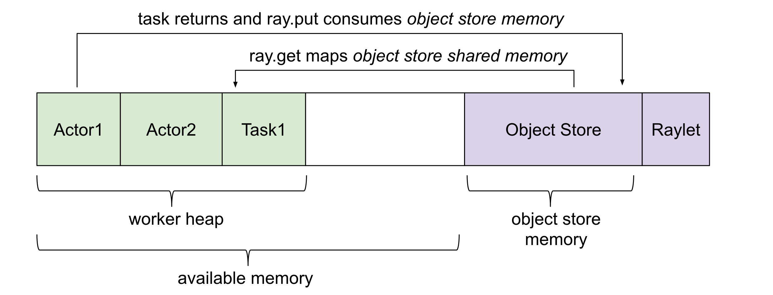
Ray: Memory Management [4]
Architecture
Object
Memory
Resource
Scheduling
Note: if an object is already present on the node, no additional allocations, which allows large objects to be efficiently shared among many actors and tasks.
Memory used by the C++ raylet process running on each node, which cannot be controlled, but is typically quite small.
Memory used by application (e.g., in Python code or TensorFlow)
Memory used when application creates objects in the object store and when returning values from remote functions. Objects are reference counted and evicted when they fall out of scope. There is an object store server running on each node.
[4] https://docs.ray.io/en/master/ray-core/objects/memory-management.html

Slide 24
Ray: Memory Management
Architecture
Object
Memory
Resource
Scheduling
For example, as shown in the figure, the primary copy (Node 2) is ineligible for eviction. However, the copies on Nodes 1 (created through `ray.get`) and 3 (created through task submission) can be evicted under memory pressure.
For remote tasks, the object value is computed by the executing worker.
If the value is small, the worker replies directly to the owner with the value, which is copied into the owner’s in-process store.
If the value is large, the executing worker stores the value in its local shared memory store.
In most cases, the primary copy is the first copy (small or large) of the object to be created. If the initial copy is lost through a failure, the owner will attempt to designate a new primary copy based on the object’s available locations.

Slide 25
Ray: Resource Management
Architecture
Object
Memory
Resource
Scheduling
Ray automatically detects physical availability of resources (CPU, GPU, and memory resource types) on each node.
User can define custom resource requirements.
Distributed scheduler matches resource requests from the owners to resource availability in the cluster.
Resource requests are hard scheduling constraints.
Resource limits are not enforced. It is up to the user to specify accurate resource requirements.
The main purposes of Ray’s resource requirements are admission control and intelligent autoscaling.

Slide 26
Ray: Resource Management
Architecture
Object
Memory
Resource
Scheduling
Autoscaler
Autoscaler (also known as the Cluster Launcher) is responsible for bringing up an initial set of cluster nodes and adding additional nodes.
It can increase the number of nodes exactly to meet resource demands (Version 1.1+)
1. Calculate the number of nodes required to satisfy all currently pending tasks, actor, and placement group requests.
2. Launch new nodes.
1) If the number of nodes required total divided by the number of current nodes exceeds `1 + upscaling_speed`, then the number of nodes launched will be limited by that threshold.
2) When nodes are launched via request_resources(), the upscaling_speed limit is bypassed.
3. If a node is idle for a timeout (5 minutes by default), it is removed from the cluster.

Slide 27
Ray: Resource Management
Architecture
Object
Memory
Resource
Scheduling
Custom Resource
In addition to native system resources such as CPU, GPU, and memory, Ray supports custom resources for each node.
For example, a node may advertise that it has a particular hardware feature.
Tasks and actors can require part of this resource for scheduling, which constrains them to run on that particular node.
Custom resources can also be added to a node dynamically by tasks.
Ray also supports multiple cluster node types, including both physical instance type (e.g., AWS p3.8xl GPU nodes vs m4.16xl CPU nodes) and other attributes (e.g., IAM role, the machine image, etc.).
Custom resources can be specified for each node type so that Ray is aware of the demand for specific node types at the application level (e.g., a task may request to be placed on a machine with a specific role or machine image via custom resource).

Slide 28
Ray: Resource Management
Architecture
Object
Memory
Resource
Scheduling
Replacement Group
Allow users to atomically reserve groups of resources across multiple nodes.
Request resource bundles that make up the group to be packed as close as possible for locality or spread apart.
Can release all resources associated with the group.
Autoscaler is aware of placement groups, and auto-scales the cluster to ensure pending groups can be placed as needed.
Multi-tenancy
Set different environment variables for workers of different jobs.
Allow multiple soft-isolated environments (e.g., different PYTHONPATH, Java CLASSPATH) within one Ray cluster.
To ensure isolation, worker processes are not reused across different jobs when multi-tenancy is enabled.

Slide 29
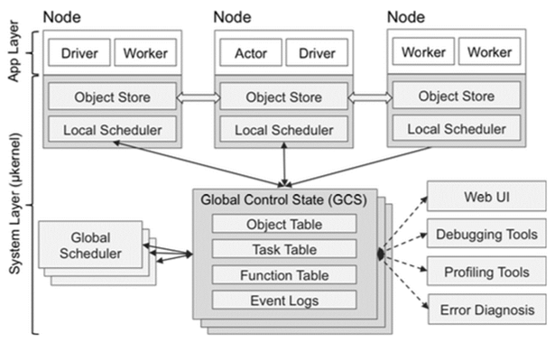
Ray: Global Control Store*
Architecture
Object
Memory
Resource
Scheduling
Heartbeat Table: hold the list of clients, workers, and nodes connected to Ray.
Each raylet periodically sends a heartbeat to the GCS to indicate that the node is alive and to report a summary of its scheduler thread’s current resource usage and load. The GCS periodically aggregates all heartbeats from the raylets, to reduce network bandwidth usage, and broadcasts the aggregate back out to all nodes. This is used to determine cluster membership and for distributed scheduling. The broadcasted information is also used for autoscaling.
If the GCS does not hear from a raylet for a configurable number of heartbeat intervals, the GCS marks the raylet as dead and broadcasts this message to all nodes. This acts as a tombstone: a raylet will exit if it hears that it has been marked as dead and its physical resources can only be reused by starting a new raylet, which is assigned a different unique ID.
Global Control Store (GCS)
The Global Control Store (GCS) is a key-value server that contains system-level metadata control state information in the system, such as the locations of objects and actors.
* It’s more than resource management, but for the simplicity of these slides, it’s put under “Resource.”

Slide 30
Ray: Global Control Store
Architecture
Object
Memory
Resource
Scheduling
Heartbeat Table: hold the list of clients, workers, and nodes connected to Ray.
Each raylet periodically sends a heartbeat to the GCS to indicate that the node is alive and to report a summary of its scheduler thread’s current resource usage and load. The GCS periodically aggregates all heartbeats from the raylets, to reduce network bandwidth usage, and broadcasts the aggregate back out to all nodes. This is used to determine cluster membership and for distributed scheduling. The broadcasted information is also used for autoscaling.
If the GCS does not hear from a raylet for a configurable number of heartbeat intervals, the GCS marks the raylet as dead and broadcasts this message to all nodes. This acts as a tombstone: a raylet will exit if it hears that it has been marked as dead and its physical resources can only be reused by starting a new raylet, which is assigned a different unique ID.
Global Control Store (GCS)
The Global Control Store (GCS) is a key-value server that contains system-level metadata control state information in the system, such as the locations of objects and actors.

Slide 31

Ray: Global Control Store
Architecture
Object
Memory
Resource
Scheduling
Actor Table: hold the list of actors and their state. This table is used to recreate actors on failure, and to manage actor lifetime.
Job Table: hold the list of jobs running in the cluster. When a job is terminated, Ray will cancel running tasks and actors created by the job to avoid resource leaks.
Object Table: the object table has been moved from the GCS into the ownership table, to improve scalability and distributed object transfer performance (v1.3).
Profile Table: store profiling events which may be LRU evicted.
Global Control Store (GCS)

